Slide 1
PowerShell - basics
Variable,Pipelining,Write-host,Write-output,Out-file,redirecting output

Slide 2
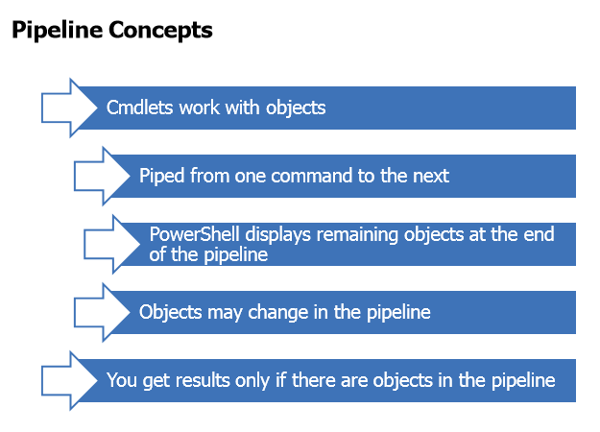
Example : Get-Service | Where {$_.Status –eq "running"}

Slide 3
Write-Host vs. Write-Output
Write-Host skips the pipeline
– Writes to the console or hosting application
– Can’t be redirected
– NO OBJECTS
Write-Output writes the pipeline – Preferred behavior
– Commands implicitly write pipelined output
– Test by piping expression to Get-Member
•Watch for –Passthru
–Some commands don’t write to the pipeline by default
PS C:\> Stop-Service wuauserv -passthru

Slide 4
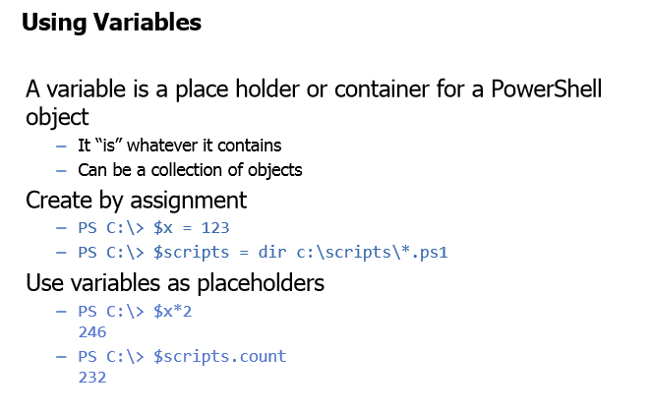

Slide 5
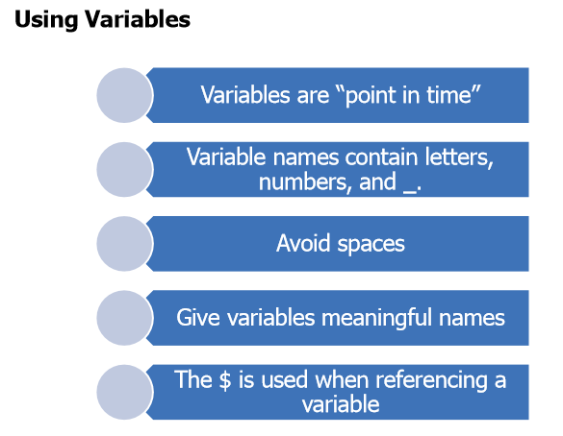

Slide 6
Subexpressions
Use parentheses to control pipelined execution
•PS C:\> get-service wuauserv –computer (get-content c:\work\computers.txt)
You can reference object properties as subexpressions
•PS C:\> $svc = get-service browser
•PS C:\> "The $($svc.displayname) service is $($svc.status)"

Slide 7
Redirecting Output
•Using Out-File
– Use –Append to add to a file
•Tee-Object
– Send to pipeline and a file
– Send to pipeline and a variable
•Out* cmdlets should be at the end of your expression
• PS C:\> dir –file -hidden | out-file –filepath c:\work\rootfiles.txt
•Write to file >
•Append to file >>
•Merge to file >&

